Slide 1
Malaria Knowledge and Communication
Follow along on Twitter!
@NMEPNigeria #NigeriaMIS
@INS_cameroun #CameroonMIS #CamerounEIP

Slide 2
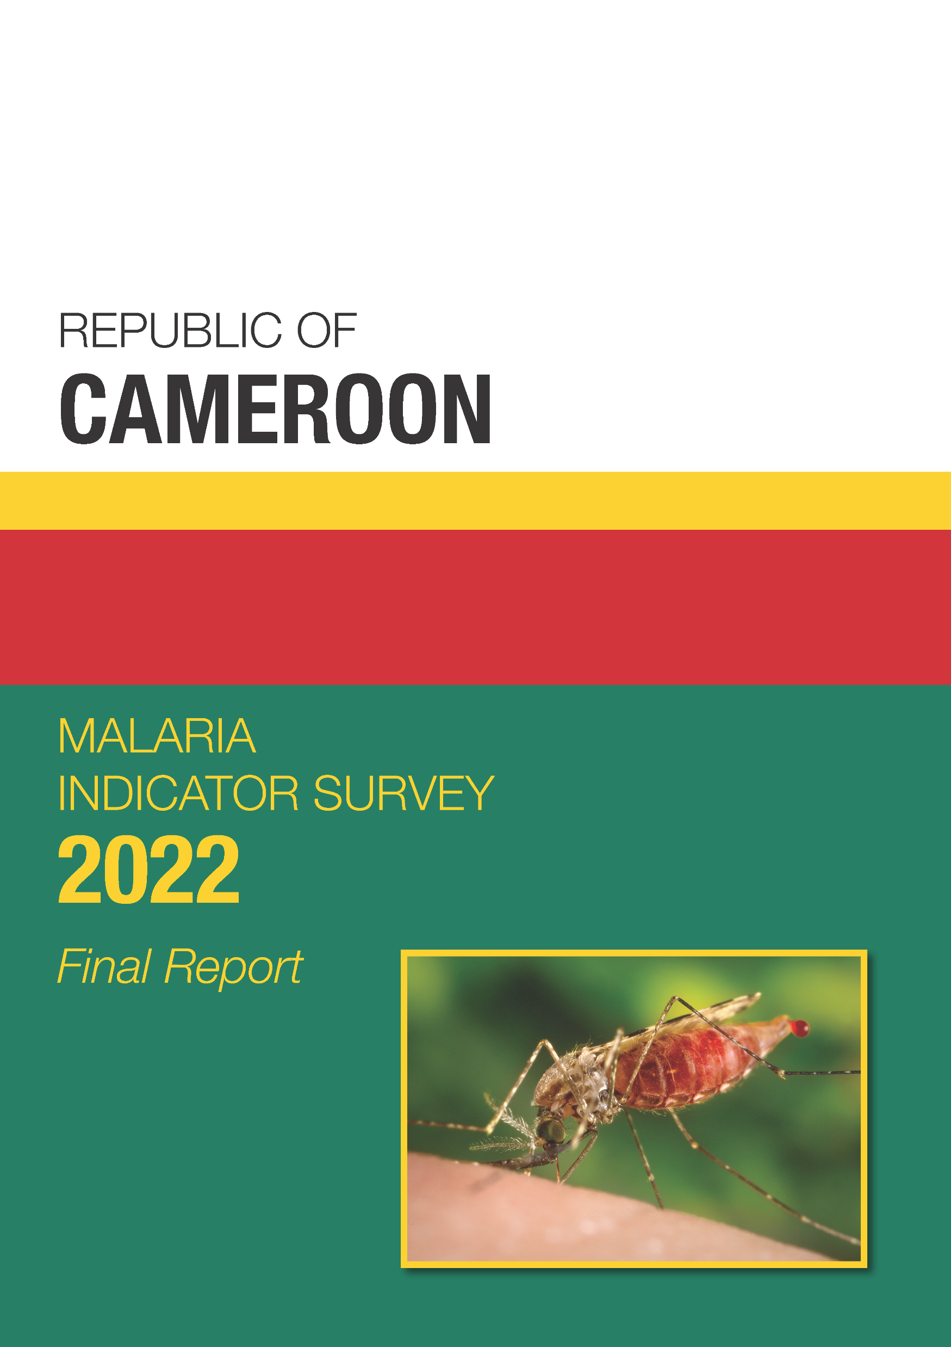
Knowledge of malaria
Malaria messages
Find these data in Chapter 5 of the Final ReportWa

Slide 3
Knowledge of Ways to Avoid Malaria by Education
Percent of women age 15-49 who know there are ways to avoid malaria
Notes:
Overall, 9 of 10 women know that there are ways to avoid malaria. 8 in 10 women with no education know at least one way to avoid malaria, compared to nearly all women with more than secondary education.
Table 5.2

Slide 4
Knowledge of Ways to Prevent Malaria
Percent of women age 15-49 who cite specific ways to avoid malaria
Notes:
Nearly all the interviewed women cited sleeping under an MII as a method to avoid malaria.
Table 5.2

Slide 5
Knowledge of malaria
Malaria messages
Find these data in Chapter 5 of the Final Report

Slide 6
Exposure to Malaria Messages by Residence
Among women age 15-49, percent who have seen or heard a message about malaria in the past 6 months
Notes:
Overall, more than half the women heard or saw a message about malaria during the last 6 months. That number varies only slightly by residence.
Table 5.1.1

Slide 7
Source of Malaria Messages
Among women age 15-49 who saw or heard a malaria message in the last six months, percent citing specific sources for malaria messages
Notes:
The most common source of malaria messages is healthcare workers (31%), followed by parents and family (30%) and television (27%).
Table 5.1.1

Slide 8
Exposure to Specific Malaria Messages
Percent of women age 15 – 49 who, in the last 6 months, recall seeing or hearing a message about:
Notes:
Regarding specific messages about malaria, the one that was most recalled was about regarding free medication for children under 5 with malaria (58%). In addition, 46% of women interviewed acknowledged the presence of a community health worker in their village or neighborhood.
Table 5.1.2

Slide 9
Key Findings
92% of women know there are ways to prevent malaria.
55% of women have seen or heard a message about malaria in the past few months.
Community health worker is the most common source of malaria messages.

